Slide 1
Business Organization and Management

Slide 2
Unit V
Indian Ethos for Management: Value-Oriented Holistic Management; Business Process Reengineering (BPR), Learning Organisation, Outsourcing
Subaltern Management Ideas from India; Diversity & inclusion; Work-life Balance; Freelancing; Flexi-time and work from home; Co-sharing/co-working.

Slide 3
Meaning of Ethos
It is a Greek word meaning character, guiding beliefs, standards and ideals that pervade a group , community or people.
Related to Ethics- set of moral standards that society expects from human behaviour.
Study of what is good and wrong in human behaviour

Slide 4
“ Indian Ethos for Management” refers to practical implementation of management concepts as recorded in our holy books.
The body of knowledge which derives its solution from the rich and huge Indian System of ethics such as :
Honesty, Hard-work, Self-confidence, Humility, persistence, passion

Slide 5
Why??
Helps in achieving success
Serves as anchor
Provide Courage
Trusts
Sincere Work

Slide 6
Ethos of Management from Indian Philosophy
Gita and Upanishad
Every person has immense potential, energy and talent
Give your best
Sacrificing personal needs for overall welfare of mankind
Character is the real power and wealth
Work is worship
Good relationship with people is more valuable than money
Avoidance of Greed
Anger leads to confusion
Be a patient listener
Perform your duties with devotion, humility and sincerity

Slide 7
Kautilya
Organization should be run actively, efficiently with well trained and righteous people.
No oppression/ exploitation of people
Proper maintenance of accounts and timely submission
No lie/contradictory statement

Slide 8
Buddha
Karma
Overcoming anger by love
Let No one deceive another
Wrongs should be endured patiently
He who has given up both victory and defeat, is contended and happy
Right belief
Right Speech
Right conduct
Right livelihood- honesty
Right mindfulness- free from greed, hatred
Right resolve- doing what is right

Slide 9
Vivekananda
Love is the law of life
Life is beautiful
Set yourself free
Don’t play blame game
Helping others
Listening to your soul
Noting is impossible
Learning everyday
Be truthful ………

Slide 10
Mahatma Gandhi
Truth and Social Service
Ahimsa(non-violence)
Trusteeship of wealth
Non-possession
Seven Blunders
Wealth without work
Pleasure without Conscience
Knowledge without character
Commerce without morality
Science without humanity
Worship without sacrifice
Politics without Principles

Slide 11
Value oriented Holistic Management
It is a value based , adaptive management framework that integrates all aspects of social, economic and environmental considerations.
It is a strategy that connects every department to work as a team

Slide 12
Characteristics of business with value oriented holistic approach
Sadhna (daily self development practice)
Resource Management
Team spirit
Shared Vision
Working for society
Versatile skills
Value oriented competence
Striving towards growth

Slide 13
Benefits of value oriented holistic management approach
Empower employees
Encourage creativity/ innovativeness
Identify challenges
Improve public image/ build goodwill
Helps in taking right decision
Teaches basic values like kindness, compassion, empathy
Open minded
Positivity
Committed
…….

Slide 14
Business Process Reengineering (BPR)
Michael Hammer & James Champy in 1990s
Reengineering is a methodology for rebuilding the way a company does things – its business processes – from scratch.
It is a systematic critical examination of existing ways of doing things with newer and better ways in order to make the work cost effective and efficient.

Slide 15
In particular, it emphasizes removing whole processes that do not deliver value. The result of this radicalism was obvious in hindsight, though not what Hammer and Champy intended.
Companies not only reduced the scope of processes and found significant shortcuts; they removed whole cadres of staff who had previously carried out the tasks that were no longer needed.

Slide 16
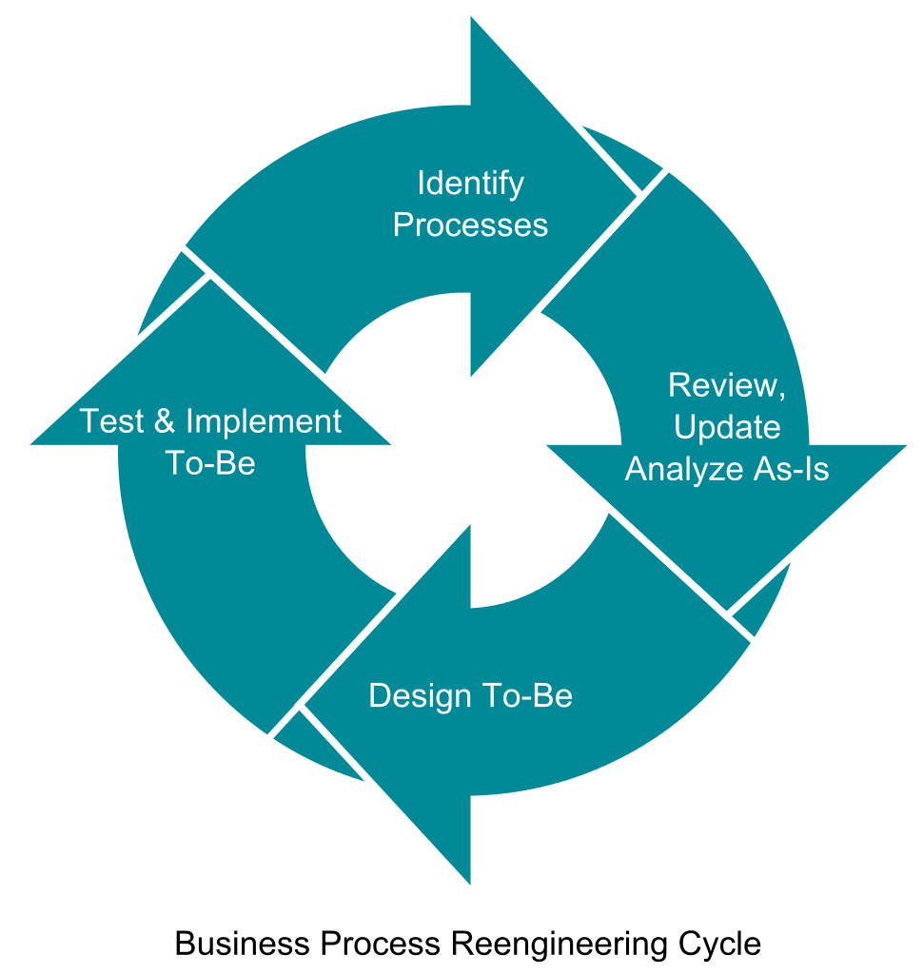

Slide 17
R’s of ReEngineering
Realisation
Requirements
Rethink
Redesign
Rebuild

Slide 18
The principles Hammer and Champy articulated included:
Organize around outcomes, not tasks.
Have those who use the output of the process perform the process.
Subsume information-processing work into the real work that produces the information.
Treat geographically dispersed resources as though they were centralized.
Link parallel activities instead of integrating their results.
Make decision making part of the process
Capture information once and at the source.

Slide 19
Reengineering Process
Preparing For Change
Planning For Change
Designing Change
Evaluating Change

Slide 20
Learning organisation
An organisation that promotes lifelong learning and knowledge generation at all levels is said to be a learning organisation
Peter Senge popularised the concept in 1990 in his book “Fifth Discipline”
According to him , “ Learning organisations are organisations where people continually expand their capacity to create the results they truly desire, where new and expansive patterns of thinking are nurtured, where collection aspiration is set free and where people are continually learning to see the whole world together”

Slide 21
Features of Learning Organisation
Cooperation and collaboration
Flexible and unstructured
Team Work
Empowerment
Information Sharing
Boundary-less organization

Slide 22
Five Disciplines of Learning organisation
Personal Mastery
Mental Models
Shared Vision
Team Learning
Systems thinking

Slide 23
Benefits
Happy Employees
A sense of community
New ideas and solutions
Smarter Employees
Less Employee Turnover
Competitive Advantage
Continuous Learning
Easy to face challenge

Slide 24
Difference between traditional and learning organisation
???????????

Slide 25
Outsourcing
Outsourcing can be defined as contracting out the non-core activities to the outside agencies who are specialized in those areas.
Objective is to get specialized benefits in terms of experience, expertise , efficiency etc…
In simple words, the services carried out by outside agencies instead of internal employees
Also referred as Business Process Outsourcing (BPO)

Slide 26
Types
Financial Services outsourcing
Advertising Services
Courier Services
IT Services
Customer Support Services
Manufacturing Services
Project outsourcing
Process specific outsourcing

Slide 27
Why outsourcing??
Cost reduction
Time savings
Expert/ specialised service
Focus on core areas
Growth throw alliance
Smooth operation of business
Contribution towards economic development
Knowledge sharing
Increased efficiency and productivity

Slide 28
Benefits/Advantages
??????????????/

Slide 29
Limitations
Threat to security and confidentiality
Dissatisfactory service
Less control
Reduces employment in home countries in case of offshore outsourcing

Slide 30
Subaltern Management Ideas from India
The term subaltern refers to individuals or groups who are socially, politically or economically marginalised or oppressed.
In India, during the British rule, Indian peasants, labour, soldier and even managers were treated as subalterns.
They had no right in expressing themselves, were denied higher managerial positions , treated as inferior etc

Slide 31
As a result, subaltern management seeks to amplify the voices of these marginalised communities and challenge the prevailing structures.
These ideas challenged the dominant managerial discourse and promote inclusivity, social justice, empowerment.

Slide 32
The ideas area as follows:
Grass root leadership
Participative decision making
Social injustice and Responsible business practice
Social entrepreneurship and community based enterprise
Cultural diversity and inclusive organizational practice
Bottom-up development and alternative metrics of progress

Slide 33
Examples of social entrepreneurs
Bindeshwar Pathak, founder of the Sulabh toilet movement who worked on a toilet design which did not require sewer lines, but converted the waste into fertiliser;
Anita Ahuja, founder of Conserve India handbags, who worked on converting plastic waste into material for handbags;
Dhruv Lakra, founder of Mirakle Couriers which hires only deaf people, who hit on the idea for Mirakle Couriers when he signed a courier package at home and realised there was no verbal communication needed;
Madhav Chavan, founder of education NGO Pratham that accelerates reading with literacy kits, and publishes the annual Status of Education report;
Anshu Gupta, founder of used clothing recycler Goonj who take used clothing from city dwellers, sort them, mend them and distribute them to needy poor;
Shaheen Mistri, founder of education initiative Akanksha, who got involved in teaching slum children via a team of volunteers and after-hours space in schools, also the founder of Teach for India;
Vinayak Lohani, founder of Parivaar Ashram for orphans, tribals and daughters of prostitutes.
These are just few names and there are a lot like them and the number is increasing day by dayThese entrepreneurs are making use of their education and technical skills in order to benefit the society.
https://digest.myhq.in/social-entrepreneurs-in-india/

Slide 34
New methods of Working
Diversity and Inclusion
Diversity is concerned with similarities and differences on gender, race, ethnicity, physical, mental ability etc..
It acts as a challenge as mangers have to deal with people from different backgrounds.
Whereas inclusivity emphasises on creating an environment where every individual feels valued, respected and empowered.

Slide 35
Diversity-Dimensions
Primary
Secondary
Gender
Age
Race
Physical ability
Mental ability
Sexual oriention
Citizenship
Income
Education
Communication style
Religious belief
General appearance
Inherent characters of individual

Slide 36
Why diversity management
Increase in diverse workforce
Morally and ethically correct
Provides competitive advantages
Prevent discrimination

Slide 37
How to manage Diversity????
Understanding current sitaution
Support from top management
Focus on Cultural change
Involvement of all employees
Embracing the different traits
Policies on equality
Sensitivity training
Working in diverse groups

Slide 38
Advantages
Creative new ideas and perspectives
Better knowledge sharing
Developing and promoting talent
Improved decision making
Enhanced problem solving
Increased employee engagement and retention
Global exposure
Read more: https://www.greatplacetowork.com/resources/blog/why-is-diversity-inclusion-in-the-workplace-important

Slide 39
Inclusion
It refers to creating an environment where every individual feels valued, respected and empowered.
Through education and awareness, diverse representation , inclusive policies , inclusive spaces ….

Slide 40
Freelancing
Freelance job is one where a person works for themselves, rather than for a company.
While freelancers do take on contract work for companies and organizations, they are ultimately self-employed.
Freelancers are responsible for all sorts of things that traditional employees are not, such as setting their work hours, keeping track of time spent on different projects, billing clients, and paying their own employment and business taxes.
Freelancers are not considered “employees” by the companies they work for, but rather “contractors.”
A freelancer is a person who is self-employed, often working for multiple clients at one time and earning income per project.

Slide 41
Social media manager
Instructor
Writer
Editor
Musician
Computer programmer
Software developer
Graphic designing
Consultancy
Etc……..

Slide 42
Principles for successful freelancing
Experience & Expertise
Capable to meet in demand services
Learning
Support network/ collaboration

Slide 43
Benefits
challenges
Flexible working hours
Independence
Skill development
Location independence
Income stability
Self discipline
Time management
Skill upgradation
Administrative responsibilities

Slide 44
Work-life Balance
It is a situation where a person chooses to equally prioritize demands of career and personal life .
It is basically giving equal time in job and time spent with family doing things that one enjoys.

Slide 45
Why WLB???
Better mental health
Improving physical health
Handling work related stress
Productivity and efficiency at work
Overall growth and development
Job satisfaction

Slide 46
Flexi time
It enables employees to have flexible work timings and schedules for better work-life balance
It is a system where people work for fixed number of hours, but can choose their arrival, departure and lunch time as per their need.

Slide 47
Advantages
disadvantages
Improved work life balance
Health benefits
Motivation
Less employee turnover
Better productivity
Communication and coordination challenge
Isolation and disconnection
Difficulty in team building

Slide 48
Work from Home
WFH is a contemporary work style allowing people to do tasks no matter where they are physically.
Also referred as telecommuting or working remotely.
Useful for better work life balance

Slide 49
Advantages
disadvantages
Expense reduction
Time saving in commuting
Flexibility
Less employee turnover
Less leaves
High degree of independence
Better WLB
High degree of distraction
Lack of personal contact
security risk
Isolation
May affect WLB

Slide 50
Co-Sharing/ Co-Working
It is a situation where people share office space temporarily or informally
Encourages collaboration and creativity among employees
Promote networking , productivity and cooperation.
Cost sharing, flexibility and access to common resource.
Can be used by freelancers or remote employees

Slide 51
Importance
Collaboration
Mentoring
Support
Flexibility
Affordability
Networking

